Slide 1
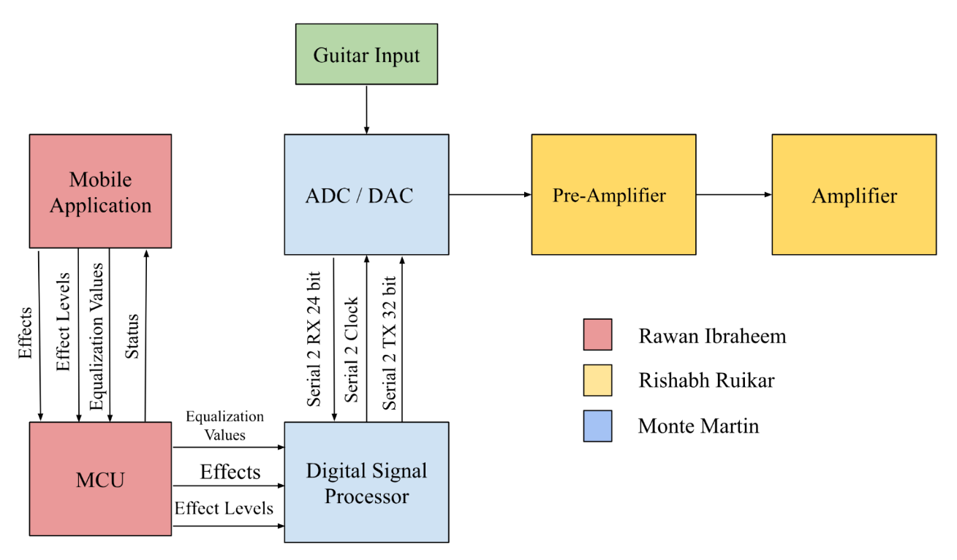
Team 28: Guitar Entertainment System
Figure 1. Guitar Entertainment System block diagram. The system will control guitar sound effects through a bluetooth connected Android application.

Slide 2
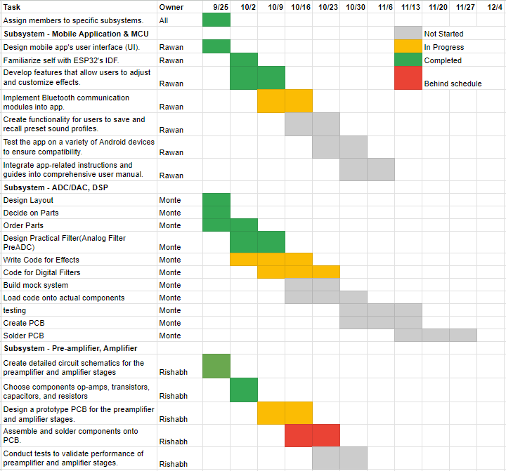
Team 28: Guitar Entertainment System
Figure 2. Timeline showing status of tasks.

Slide 3
Amplifier Rishabh Ruikar
Accomplishments since the last presentation 12 hrs | Ongoing progress/problems and plans until the next presentation
Finished all digital simulations, and tweaked all relevant values (resistor and capacitor) to my liking Added potentiometers for equalization | Have a completed PCB by next presentation, ideally have it ready for fabrication by 10/23

Slide 4
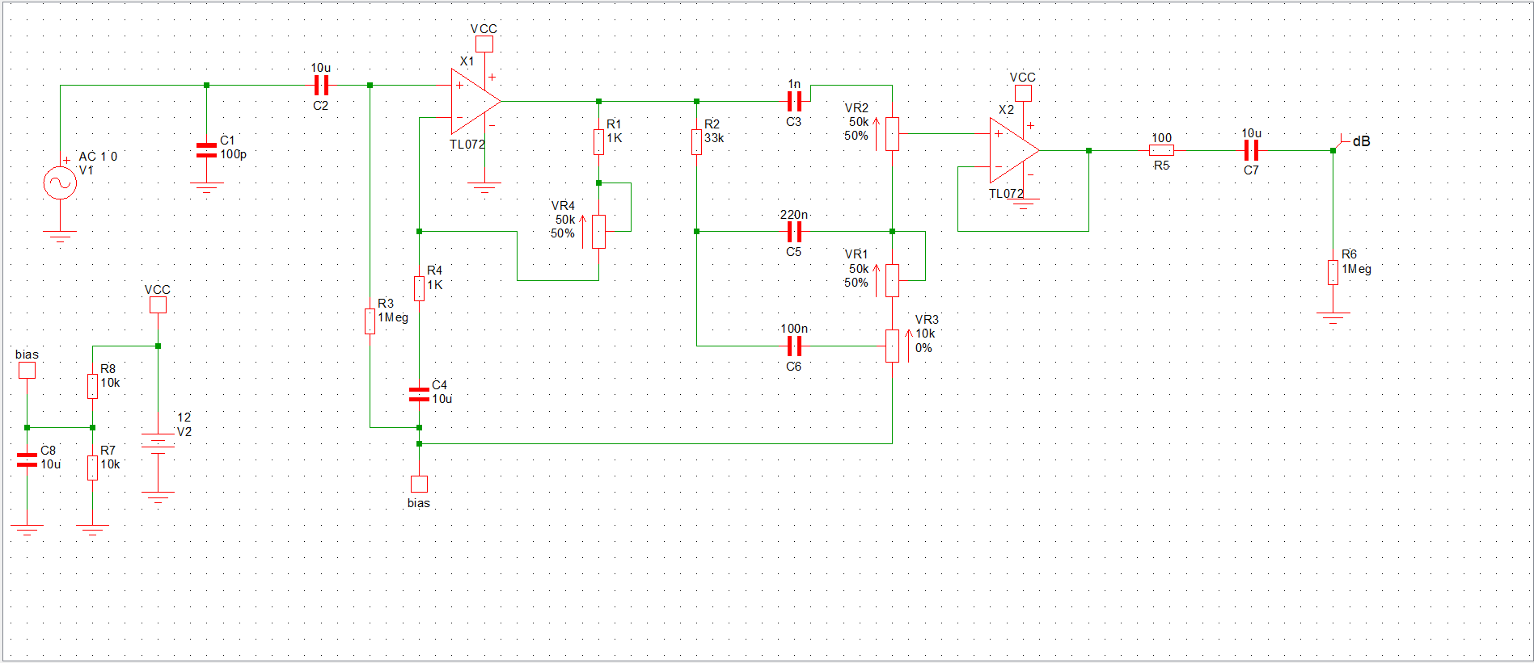
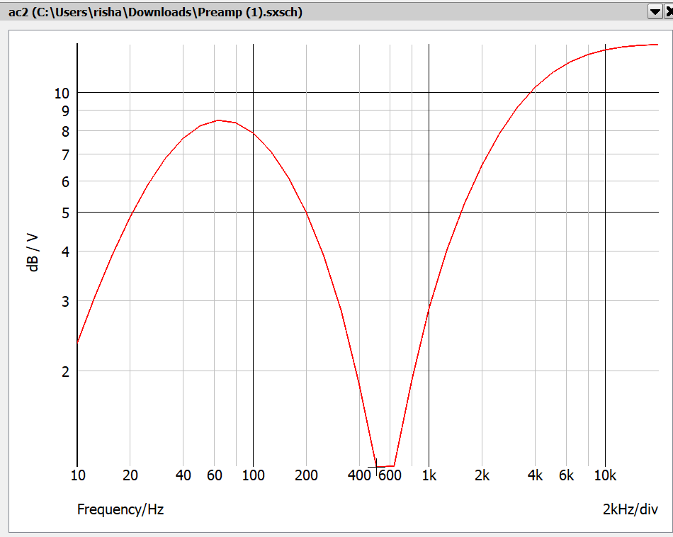
Figure 3. Amplifier Circuit Diagram.
Figure 4. Amplifier AC Simulation Graph (400-1kHz represents muddy frequency).

Slide 5
DSP/ADC/DAC Monte Martin
Accomplishments since the last presentation <12> hrs | Ongoing progress/problems and plans until the next presentation
Selected designs for ADC input Buffer, Reference, and Clock, and created schematic footprint Selected Hardware Configuration for DAC, as well as schematic footprint | Currently finalizing schematics and beginning PCB work Coding effects and the DSP

Slide 6
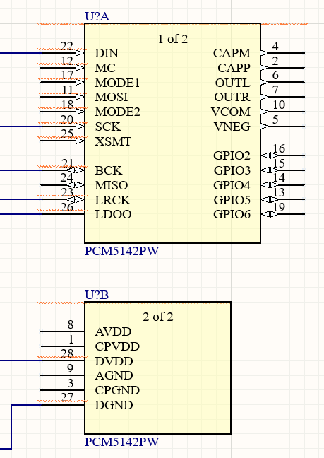
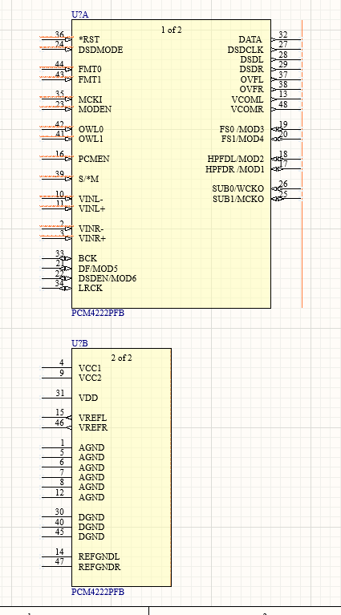
Figure 5. DAC Schematic Model.
Figure 6. ADC Schematic Model.

Slide 7
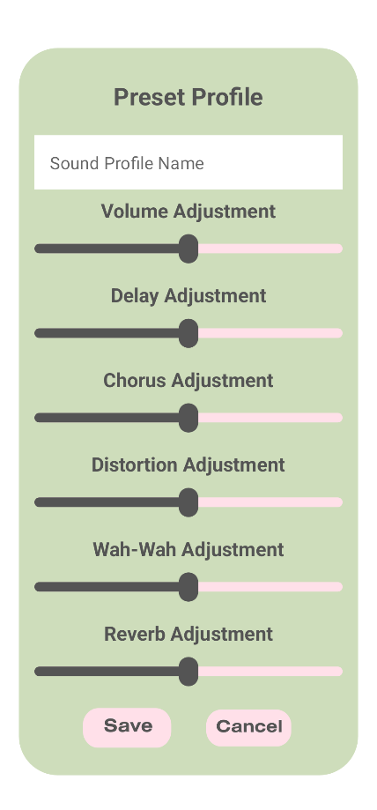

Application and MCU Code Rawan Ibraheem
Accomplishments since the last presentation 15 hrs | Ongoing progress/problems and plans until the next presentation
Ran app on emulator without crashing Fixed navigation issues, changed from navigation graph to a different method Implemented functionality for all effects Ran the effects on emulator to ensure the slider, save, and close buttons work | Implement Bluetooth communication modules into app. Create functionality for users to save and recall preset sound profiles.
The device uses 1-14% CPU on a Pixel 7 and uses an average of 197.4 MB of memory. It is expected to use more memory as users add and save sound effect profiles.
Figure 7. Application simulated on Google Pixel 7 in Android Studio.
Figure 8. UI element for creating a sound effect profile.

